Slide 1

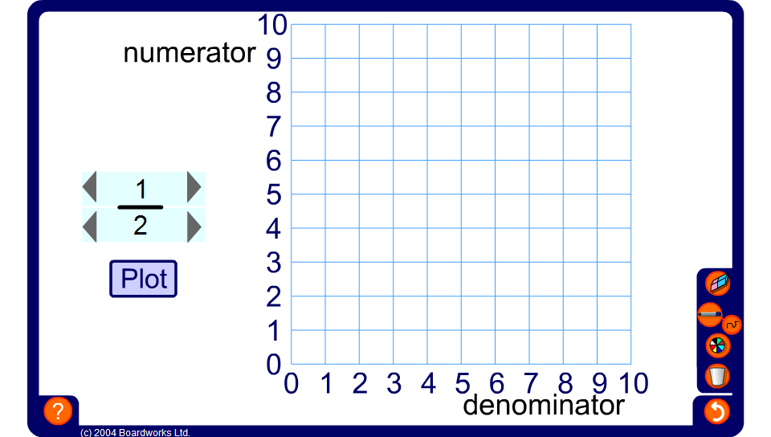


Using a graph to compare fractions
Notes:
Tell pupils that we can use a graph to compare fractions by plotting the numerator against the denominator and drawing a line from the point to the origin. The steeper the line, the greater the fraction.
Links:
A5 Functions and graphs - Graphs of functions (Finding the gradient of a straight line).

